Slide 2
CARBOHYDRATES
Life’s Sweet Molecules
-Carbohydrates are the most abundant organic molecules in nature.
-Carbo-Hydrates means “Hydrates of carbon.” also called saccharides,
means “sugars.”
which
-Carbohydrates are defined as polyhydroxyaldehydes or polyhydroxyketones or compounds which produce them on hydrolysis.
-Composed of
-carbon hydrogen oxygen
Sulphur, Nitrogen or Phosphorus

Slide 3
-They act as storehouses of chemical energy (glucose, starch, glycogen); are the components of supportive structures in plants (cellulose), crustacean shells (chitin) and connective tissues in animals (acidic polysaccharides) and are essential components of nucleic acids (D-ribose and 2-deoxy-D-ribose).
-Carbohydrates make up about three fourths of the dry weight of plants. But in animals it is less than 1%.
General molecular formula - C_{n}H_{2n}O_{n}
According to number of sugar subunits there are different types of Carbohydrates.

Slide 4
- Animals get their carbohydrates by eating plants but they do not store much, than they consume.
-Carbohydrates are produced by photosynthesis in plants, such as glucose are synthesized in plants from CO₂, H₂O, and energy from the sun. Then, are oxidized in living cells to produce CO₂, H₂O, and energy.

Slide 5
Each year, 100 metric tons of CO₂ is converted to Carbohydrates by plants

Slide 6
Carbohydrates
Disaccharides 2 sugar units
Oligosaccharides 3-10 units
Polysaccharides
>10
e.g.Glucose,
fructose etc
e.g. Maltotriose
e.g.Sucrose
Homoglycans
e.g. starch, glycogen
Heteroglycans
e.g. GAGs or glycosaminoglycans

Slide 7
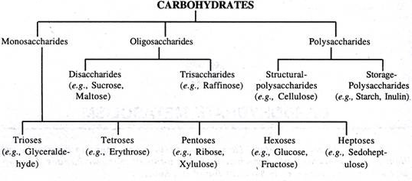

Slide 8
1.
Simplest and consist of one sugar molecule. Carbohydrates that cannot be hydrolysed into simpler carbohydrates are called as monosaccharides.
Sucrose (C₁₂H₂₂O₁₁) + H₂O
Disaccharides
acid or certain enzyme
Glucose (C₆H₁₂O₆) + Fructose (C₆H₁₂O₆)
Monosaccharides
Structure and Nomenclature
The general formula C_{n}H_{2n}O_{n}
With one of the carbons being the carbonyl group of either an aldehyde or a ketone.
The most common monosaccharides have three to seven carbon atoms.
The suffix-ose indicates that a molecule is a carbohydrate, and the prefixes tri,
tetr-, pent-, and so forth indicate the number of carbon atoms in the chain
like, triose, tetrose, pentose, etc.

Slide 9
Monosaccharide further classified on the basis of functional group and number of carbon atoms present in their structure
On the basis of no. of carbon atom On the basis of functional group
No. of carbon atom
Generic name
ALDOSE
KETOSE
Aldotriose e.g. glyceraldehyde
Ketotriose e.g. Dihydroxyacetone
3
Trioses
Aldotetrose e.g.
Erythrose
Ketotetrose e.g.
Erythrulose
4
Tetroses
Aldopentoses e.g
Arabinose, Xylose, Ribose
5
Pentoses
Ketopentoses e.g.
Xylulose, Ribulose
Aldohexose e.g. Glucose, Galactose, Mannose
6
Hexoses
Ketohexose e.g. Fructose

Slide 10
PROPERTIES OF MONOSACCHARIDES
Physical properties:
Monosaccharides are colourless, crystalline compounds, readily soluble in water and sweet in taste. Their solutions are optically active and exhibit mutarotation.

Slide 11
Trioses
EMB-RCG
Chemistry of Carbohydrate
The smallest monosaccharides
Include glyceraldehyde and dihydroxyacetone
Aldehyde and ketone derivatives of trihydric alcohol, glycerol
I
mportant energy source and provides the basic carbon skeleton

Slide 12
C₁ | CHO | | CH₂OH |
C₂ | CHOH | | C = O |
C₃ | CH₂OH | CH₂OH
 | Glyceraldehyde | Dihydroxyacetone

Slide 13
2.
When two monosaccharides (similar or dissimilar) are combined together by glycosidic linkage, a disaccharide is formed.
All are isomers with molecular formula ^{C}12^{H}22^{O}11
On hydrolysis they yield 2 monosaccharide which soluble in water
Even though they are soluble in water, they are too large to pass through the cell membrane.
There are two types
Non-reducing
Sucrose Trehalose
Cane sugar in yeast
Reducing
Lactose Maltose
Milk sugar Malt sugar

Slide 14
Tetroses
EMB-RCG
Chemistry of Carbohydrate
4 Carbon sugar. The only tetrose of some importance in human beings is D-erythrose
This is formed as an intermediate (as erythrose-4- phosphate) during the metabolism of glucose.
Calvin cycle

Slide 15
CHO
|
H — C — OH
|
H — C — OH
| CH₂OH
D-Erythrose
C₁
C₂
C₃
C₄

Slide 16
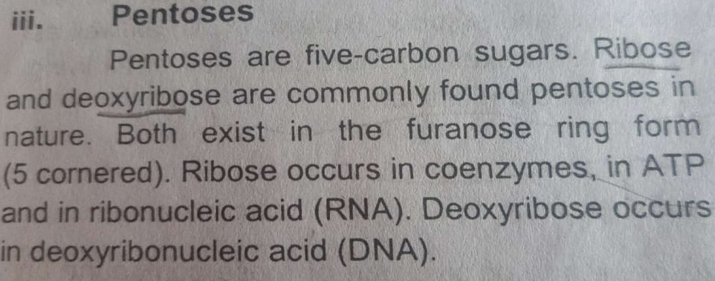
Pentoses

Slide 17
CHO | H — C — OH | H — C — OH
|
H — C — OH
|
CH₂OH
D-Ribose | Deoxyribose

Slide 18
CHO | H — C — OH | HO — C — H | H — C — OH | CH₂OH | CH₂OH | C = O | HO — C — H | H — C — OH | CH₂OH | CH₂OH | C = O | H — C — OH | HO — C — H | CH₂OH
D-Xylose | D-Xylulose | L-Xylulose

Slide 19
Hexoses
EMB-RCG
Chemistry of Carbohydrate
The important aldohexoses in human beings are D-glucose, D-galactose and D-mannose
The important ketohexose is D-fructose which is the ketoisomer of D-glucose

Slide 20
D-Glucose is the most important carbohydrate in human beings
EMB-RCG
Chemistry of Carbohydrate
CHO
|
H — C — OH
|
HO — C — H
|
H — C — OH
|
H — C — OH
|
CH₂OH
D-Glucose

Slide 21
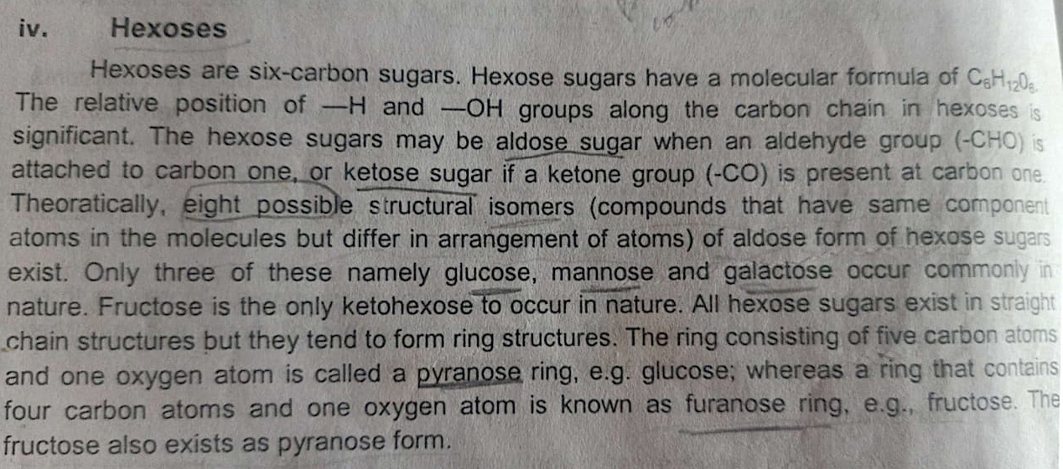
Hexoses

Slide 22
EMB-RCG
Chemistry of Carbohydrate
The carbohydrates are transported in blood in the form of D-glucose
This is the form in which carbohydrates are used by the tissues to obtain energy
Most other carbohydrates are converted into D-glucose in the body
The important polysaccharides, starch, dextrin and glycogen are made up of D-glucose

Slide 23
D-Galactose is present in glycolipids which are an important constituent of nervous tissue
EMB-RCG
Chemistry of Carbohydrate
It is also present disaccharide, lactose
in milk in the form of the
Amino derivatives of D-galactose and D-mannose are present in mucopolysaccharides and glyco- proteins

Slide 24
CH₂OH
|
Formed in some path- ways of carbohydrate metabolism
C = O
|
HO — C — H
|
H — C — OH
|
H — C — OH
|
Also present in seminal fluid; provides nourish- ment to sperms
CH OH
2
D-Fructose

Slide 25
Tetroses
EMB-RCG
Chemistry of Carbohydrate
The only tetrose of some importance in human beings is D-erythrose
This is formed as an intermediate (as erythrose-4- phosphate) during the metabolism of glucose via the hexose monophosphate shunt pathway
The corresponding ketotetrose is D-erythrulose

Slide 26
CHO
|
H — C — OH
|
H — C — OH
| CH₂OH
D-Erythrose
C₁
CH₂OH
|
C = O
|
H — C — OH
| CH₂OH
D-Erythrulose
C₂
C₃
C₄

Slide 27
Pentoses
EMB-RCG
Chemistry of Carbohydrate
D-Ribose and 2-deoxy-D-ribose are the most important pentoses which are the constituents of nucleic acids and nucleotides
D-Ribose D-ribulose
and its corresponding ketopentose, are formed as intermediates in the
hexose monophosphate shunt
28

Slide 28
CHO | H — C — OH | H — C — OH | CH₂OH | C = O | H — C — OH
| | |
H — C — OH | H — C — OH
| | |
CH₂OH | CH₂OH
D-Ribose | D-Ribulose

Slide 29
EMB-RCG
Chemistry of Carbohydrate
Another pentose formed in HMP shunt pathway is D-xylulose
Its corresponding aldopentose is D-xylose
D-Xylose is used as a diagnostic agent to study intestinal absorption

Slide 30
An L-pentose occurring in human beings is L-xylulose
EMB-RCG
Chemistry of Carbohydrate
L-Xylulose is formed as an intermediate in the uronic acid pathway of carbohydrate metabolism
It is excreted in urine in detectable amounts in a hereditary disease, essential pentosuria

Slide 31
CHO | H — C — OH | HO — C — H | H — C — OH | CH₂OH | CH₂OH | C = O | HO — C — H | H — C — OH | CH₂OH | CH₂OH | C = O | H — C — OH | HO — C — H | CH₂OH
D-Xylose | D-Xylulose | L-Xylulose

Slide 32
Hexoses
EMB-RCG
Chemistry of Carbohydrate
The important aldohexoses in human beings are D-glucose, D-galactose and D-mannose
The important ketohexose is D-fructose which is the ketoisomer of D-glucose

Slide 33
D-Glucose is the most important carbohydrate in human beings
EMB-RCG
Chemistry of Carbohydrate
CHO
|
H — C — OH
|
HO — C — H
|
H — C — OH
|
H — C — OH
|
CH₂OH
D-Glucose

Slide 34
EMB-RCG
Chemistry of Carbohydrate
The carbohydrates are transported in blood in the form of D-glucose
This is the form in which carbohydrates are used by the tissues to obtain energy
Most other carbohydrates are converted into D-glucose in the body
The important polysaccharides, starch, dextrin and glycogen are made up of D-glucose

Slide 35
D-Galactose is present in glycolipids which are an important constituent of nervous tissue
EMB-RCG
Chemistry of Carbohydrate
It is also present disaccharide, lactose
in milk in the form of the
Amino derivatives of D-galactose and D-mannose are present in mucopolysaccharides and glyco- proteins

Slide 36
CHO
|
H — C — OH
|
HO — C — H
|
HO — C — H
|
H — C — OH
| CH₂OH
D-Galactose
CHO
|
HO — C — H
|
HO — C — H
|
H — C — OH
|
H — C — OH
|
CH₂OH
D-Mannose

Slide 37
CH₂OH
|
Formed in some path- ways of carbohydrate metabolism
C = O
|
HO — C — H
|
H — C — OH
|
H — C — OH
|
Also present in seminal fluid; provides nourish- ment to sperms
CH OH
2
D-Fructose

Slide 38
Disaccharides
EMB-RCG
Chemistry of Carbohydrate
Made up of two monosaccharide molecules linked by a glycosidic bond
Mostly found in plants
Important ones are sucrose, maltose and lactose
38

Slide 39
SSuuccrorossee
EMB-RCG
Chemistry of Carbohydrate
Is the common sugar (cane sugar)
table
Occurs in cane, beet, maple and many fruits
Is made up of glucose and fructose
39

Slide 40
EMB-RCG
Chemistry of Carbohydrate
CH₂OH
O
H
H
H
OH H
1
OH
Carbon atom 1
H
OH
of glucose linked to carbon atom 2 of fructose by a glyco-
sidic bond
Sucrose
O
CH2OH
O
2
H OH
H
CH₂OH
OH
H
40

Slide 42
Since the anomeric carbon of fructose (carbon atom 2) has got a β-configuration, the glycosidic bond is said to be a β-glycosidic bond
EMB-RCG
Chemistry of Carbohydrate
Therefore, sucrose may be described as
α-D-glucopyranosyl-β-D-fructofuranoside
42

Slide 43
Sucrose is dextrorotatory (+66.5º)
EMB-RCG
Chemistry of Carbohydrate
When it is hydrolysed, an equi-molar mixture of glucose and fructose is formed
Of these, glucose is dextrorotatory (+52.5º) and fructose is laevorotatory (–92.3º)
43

Slide 44
Laevorotation caused by fructose is greater than the dextrorotation caused by glucose
EMB-RCG
Chemistry of Carbohydrate
Therefore, the hydrolysate is laevorotatory
As the optical rotation is inverted on hydrolysis, sucrose is described as invert sugar
44

Slide 45
Maltose
EMB-RCG
Chemistry of Carbohydrate
Does not occur as such in nature usually
Formed during the hydrolysis of polysaccharides
Made up to two glucose molecules linked by an α-glycosidic bond
45

Slide 46
EMB-RCG
Chemistry of Carbohydrate
CH₂ OH
CH₂ OH
O
H
1
O
H
H
H
4
H
H
OH
H
OH H
O
OH
OH
H
OH
H
OH
α-Maltose
46

Slide 47
Carbon atom 1 of one molecule is linked to carbon atom 4 of the second
EMB-RCG
Chemistry of Carbohydrate
The carbon atom 1 (anomeric carbon) of the second glucose molecule is free, and may possess an α- or a β-configuration
Therefore, maltose may exist as α-maltose or
β-maltose
47

Slide 48
Anomeric carbon of the first glucose molecule, involved in bonding, possesses α-configuration
EMB-RCG
Chemistry of Carbohydrate
Therefore, the bond is an α-glycosidic bond
The α-form of maltose may be described as α-D- glucopyranosyl-α-D glucopyranoside
48

Slide 49
Sucrose (glucose+ fructose)
Sucrose is known as table sugar.
It is the most abundant disaccharide found in nature.
Sucrose is found in sugar cane and sugar beets.
The glycosidic bond is α β (1→ 2).
Both anomeric carbons of the monosaccharides in sucrose are bonded, therefore, sucrose is non-reducing sugar. It will not react with Benedict’s reagent. Also it not form osazone crystals in osazone test.
When hydrolyzed, it forms a mixture of glucose and fructose
Clinical Importance:-
-dental caries
-Bypasses metabolic
check points- OBESITY
-Sucrase deficiency

Slide 50
Inversion of Sucrose
Hydrolysis of sucrose (optical rotation +66.5º) will produce one molecule of glucose (+52.5º) and one molecule of fructose (-92º)
Therefore the products will change the dextrorotation to levorotation
(INVERSION)
Equimolecular mixture of glucose and fructose thus Invert Sugar
formed is called as
The enzyme producing hydrolysis of sucrose is called INVERTASE

Slide 51
Maltose (glucose+ glucose)
Maltose is known as malt sugar.
2 glucose residues α (1 → 4) linkage
Another form is α (1 → 6) called as Isomaltose.
It is formed by the breakdown of starch. Malted barley, a key ingredient in beer, contains high levels of maltose.
During germination of barley seeds, the starch goes through hydrolysis to form maltose. This process is halted by drying and roasting barley seeds prior to their germination.
One of the anomeric carbons is free, so maltose is a reducing sugar.
Osazone test:- Star shaped or flower petal shaped

Slide 52
Lactose (galactose+ glucose)
Lactose is known as milk sugar.
It is found in milk and milk products.
The glycosidic bond is (1→4).
An intolerance to lactose can occur in people who inherit or lose the ability to produce the enzyme lactase that hydrolyzes lactose into its monosaccharide units.
One of the anomeric carbons is free, so lactose is a reducing sugar.
Osazone test – Powder Puff or hedgehog shaped

Slide 53
3. Polysaccharides
Polysaccharides are large molecules containing 10 or more monosaccharide units. Carbohydrate units are connected in one continuous chain or the chain can be branched.
Storage polysaccharides contain only α- glucose units. Three important ones are starch, glycogen, and amylopectin.
Structural polysaccharides contain only β- glucose units. Two important
ones are cellulose and chitin. Chitin contains a modified β- glucose unit
Heteroglycan Or
Heteropolysaccharide
Homoglycan Or Homopolysaccharide

Slide 54
Homopolysaccharides (all one type of monomer), e.g., glycogen, starch, cellulose, chitin, inulin, dextran.
Heteropolysaccharides (different types of monomers), e.g., peptidoglycans, glycosaminoglycans
Unbranched/ Linear polysaccharides
Branched polysaccharides

Slide 55
HOMOPOLYSACCHARIDES
Starch
Carbohydrates of the plant kingdom
Sources: Potatoes, tapioca, cereals (rice, wheat) and other food grains
Starch is a homopolymer composed of D-glucose units held by α-glycosidic bonds.
Composed of two polysaccharide components-Amylose & Amylopectin
Amylose:
Amylose makes up 20% of plant starch and is made up of 250–4000 D
glucose units bonded α (1→4) in a continuous chain.
Long chains of amylose tend to coil.
Mol wt =400,000 or more
It is water soluble
α -amylose

Slide 56
Amylopectin:
The insoluble gel;
part absorbs water and forms paste like
Amylopectin makes up 80% of plant starch and made up of glucose units, but is highly branched with molecular weight more than 1 million.
The branching points are made by α- 1, 6 linkage

Slide 57
Hydrolysis of Starch
About every 25 glucose units of amylopectin, a branch of glucose units are connected to the glucose by an α(1→6) glycosidic bond.
During fruit ripening, starch undergoes hydrolysis of the α(1→4) bonds to produce glucose and maltose, which are sweet.
When we consume starch, our digestive system (α-amylase)breaks it down into glucose units for use by our bodies.
Starch will form a blue coloured complex with iodine; this color disappears on
heating and reappears when cooled. This is a sensitive test for starch.
When starch is hydrolyzed by mild acid, smaller and smaller fragments are produced.
The hydrolysis for a short time produces amylodextrin (violet color with iodine and non-reducing).
Further hydrolysis…………….amylodex→erythrodex→archrodextrin→ Maltose

Slide 58
Glycogen
Storage form of energy in animal. Stored in liver and muscle
Stores more glucose residues per gram than starch.
More branched and compact than starch.
A homopolysaccharide (number of glucose units upto 25000): linear chain of α (1→4) linked glucosyl residues with branches joined by α (1→6) linkages
More energy in a smaller space.
Glycogen in liver (6-8%) is higher than that in the muscles (1-2%).
Liver glycogen - first line of defense against declining blood glucose levels especially between meals.

Slide 59
Cellulose
Glucose units combined by β-1,4 linkages.
Straight line chain with no branches. This allows chains to align next to each
other to form a strong rigid structure.
Mol wt 2-5 million.
Cellulose is an insoluble fiber in our diet because we lack the enzyme cellulase to hydrolyze the β-1,4 glycosidic bond. Whole grains are a good source of cellulose. Cellulose is important in our diet because it assists with digestive movement in the small and large intestine. Some animals and insects can digest cellulose because they contain bacteria that produce cellulase.
Commercial applications: nitrocellulose, cellulose acetate membranes for electrophoresis.

Slide 60
Chitin
Chitin makes up the exoskeleton of insects some fungi.
and crustaceans and cell walls of
It is made up of N-acetyl glucosamine containing β(1→4) glycosidic bonds.
It is structurally strong.
Chitin is used as surgical thread that biodegrades as a wound heals.
It serves as a protective Exoskeleton in crustacea and insects.
Chitin is also used to waterproof paper, and in cosmetics and lotions to retain
moisture.

Slide 61
Dextrins/Dextrans
Highly branched homoglycan containing Glucose residues in 1-6, 1-4 and 1-3 linkages.
Produced by microbes.
Mol. wt:- 1-4 million.
As large sized, they will not move out of vascular compartment so used as plasma expanders.
Inulin
D -fructose in β-1,2 linkages.
Source: Bulbs and tubers chicory, dahlia, dandelion, onions, garlic.
Not metabolized .
Not absorbed nor secreted by kidneys so, used to measure GFR.

Slide 62
HETEROPOLYSACCHARIDES
Polymers made from more than one kind of monosaccharides or monosaccharide derivatives. e.g., mucopolysaccharides, Agar & Agarose and glycoproteins.
MUCOPOLYSACCHARIDES
First isolated from mucin so called mucopolysaccharides
Long, Unbranched heteropolysaccharide, made of
repeating disaccharide
units containing uronic acid & amino sugars. These are more commonly
known as Glycosaminoglycans (GAG).
Amino sugar – Glucosamine or Galactosamine (Present in there acetylated form)
Uronic acid – D-Glucuronic acid
Major components of extracellular matrix of connective tissue, including bone and cartilage, synovial fluid, vitreous humor and secretions of mucus producing cells.

Slide 63
Sulfate free Hyaluronic acid
Sulfate containing
Hyaluronic acid
It is the simplest mucopolysaccharide and is a linear polymer of disaccharides which form the repeating unit.
Each disaccharide is linked to the next by β- 1,4 glycosidic bonds. It consists of
two alternative units of D-glucuronic acid and N-acetyl D-glucosamine, linked
by β-1,3 to give a thread like structure.
Present in Synovial fluid of joints, vitreous humor, connective tissues and cartilage.
Chondroitin Sulphate, Dermatan sulphate, keratan sulphate, Heparin, Heparan Sulphate

Slide 64
Functions:
Serves as a lubricant and shock absorbant in joints.
Acts as seives in extracellular matrix.
Permits cell migration during morphogenesis & wound repair.
Hyaluronidase is an enzyme that breaks β1 – 4 linkages of hyaluronic acid.
Present in high concentration in seminal fluid, & in certain snake and insect venoms. Hyaluronidase enzyme of semen degrades the gel around ovum & allows effective penetration of sperm into ovum, thus helps in fertilization.
Condroitin sulphates
Widely distributed in bone, cartilage, skin, heart & tendons. The repeating unit is a disaccharide and consisting of alternate units of D-glucuronic acid linked to sulphate ester of N- acetyl galactosamine.
Functions:
In cartilage, it binds collagen & hold fibers in a tight strong network.
Role in Compressibility of cartilages in weight bearing.

Slide 65
Heparin
Heparin is a medically important polysaccharide because it prevents clotting in the bloodstream.
It is a highly ionic polysaccharide of repeating disaccharide units of an oxidized monosaccharide and D-glucosamine. Heparin also contains sulfate groups that are negatively charged.
present intracellular: In granules of mast cells and also in lung, liver and skin.
Functions:
It is an anticoagulant (prevents blood clotting)
Heparin helps in the release of the enzyme lipoprotein lipase (LPL) which helps to clear the lipidemia after fatty meal – so called clearing factor.

Slide 66
AGAR
Contains galactose, glucose & other sugars. Obtained from sea weeds
Functions:
Cannot be digested by bacteria. So used as supporting agent to culture bacterial colonies.
Also as support medium of immuno diffusion & immuno-electrophoresis.
AGAROSE
Galactose and 3,6 anhydrous galactose units. Used as matrix for electrophoresis.
GLYCOPROTEINS
Several proteins are covalently bound to carbohydrates which are referred to as glycoproteins. The carbohydrate content of glycoproteins varies from 1% to 90% by weight. The term mucoprotein is used for glycoproteins with carbohydrate concentration more than 4%. Glycoproteins are very widely distributed in the cells and perform variety of functions like enzymes, hormones, transport proteins, structural proteins, blood group antigens and receptors.
The carbohydrates found in glycoproteins include mannose, galactose, N-acetyl glucosamine, N-acetyl galactosamine, xylose and N-acetylneuraminic acid (NANA)

